Slide 1
SEMPY02
M1L2: Introduction to Quantum Mechanics

Slide 2
How we’re going to do this class
I want to kind of give you a flavor of how a research group works
I’m going to give lectures essential on silicon
You are get assign a semiconductor material
Tuesday of every class (prepare a slide, your material, and what you have done toward the assessment)

Slide 3
Semiconductors
GaAs (TORRES)
GaN (Tan)
InP (Fernandez)
Ge (Samaco)
SiC (Sy)
ZnO (Sebastian)
CdTe (Paz)
InAs (Madrid)

Slide 4
Presentation for Next Class
Electron in Free Space (QM??)
Infinite Potential Well (SOLST01 review)
The Step Potential Function (QM??)
The Potential Barrier (QM??)
Free electron with PBC 1D (SOLST01 review)
Free electron with Cosine Potential 1D (SOLST01 review)
Real world bandgap diagrams (relate to high symmetry points)

Slide 5
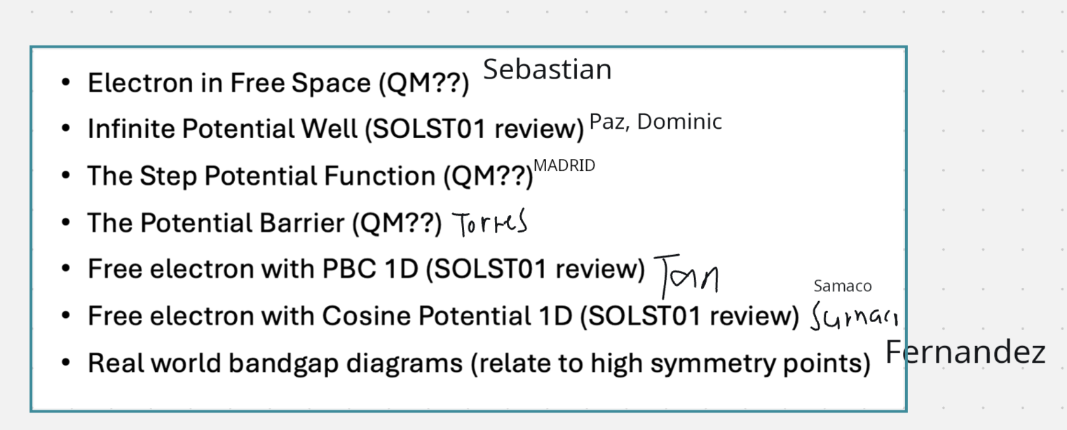
Presentations
Statistical Mechanics (Boltzman, Fermi Dirac, and Density of States) - SY

Slide 7
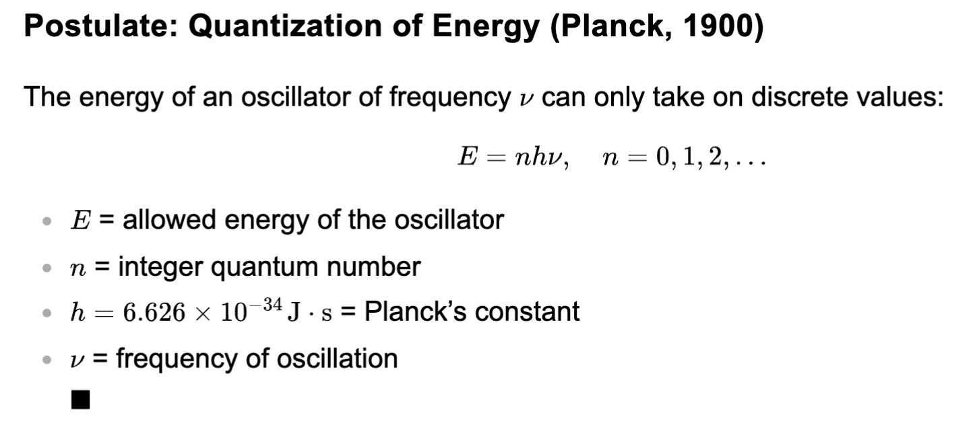
Quantization of Energy
Planck (1900)
  Blackbody Radiation Problem
  UV Catatrophy Effect
  Raleigh-Jean Formula Radiation did not for Blackbody Problems

Slide 8
Have you seen the Plank’s constant solved for?
Raleigh Jean Formula
Make the adjust’s Planck had
Solve for h?
Prof Ragasa will make a Jupiter notebook for this.

Slide 9

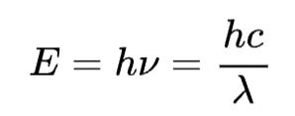
Photo Electric Effect
Einstein 1905
  Energy of Light (EM waves)
  Relates energy to wavelength
  The minimum amount of energy to do this known as the work function

Slide 10
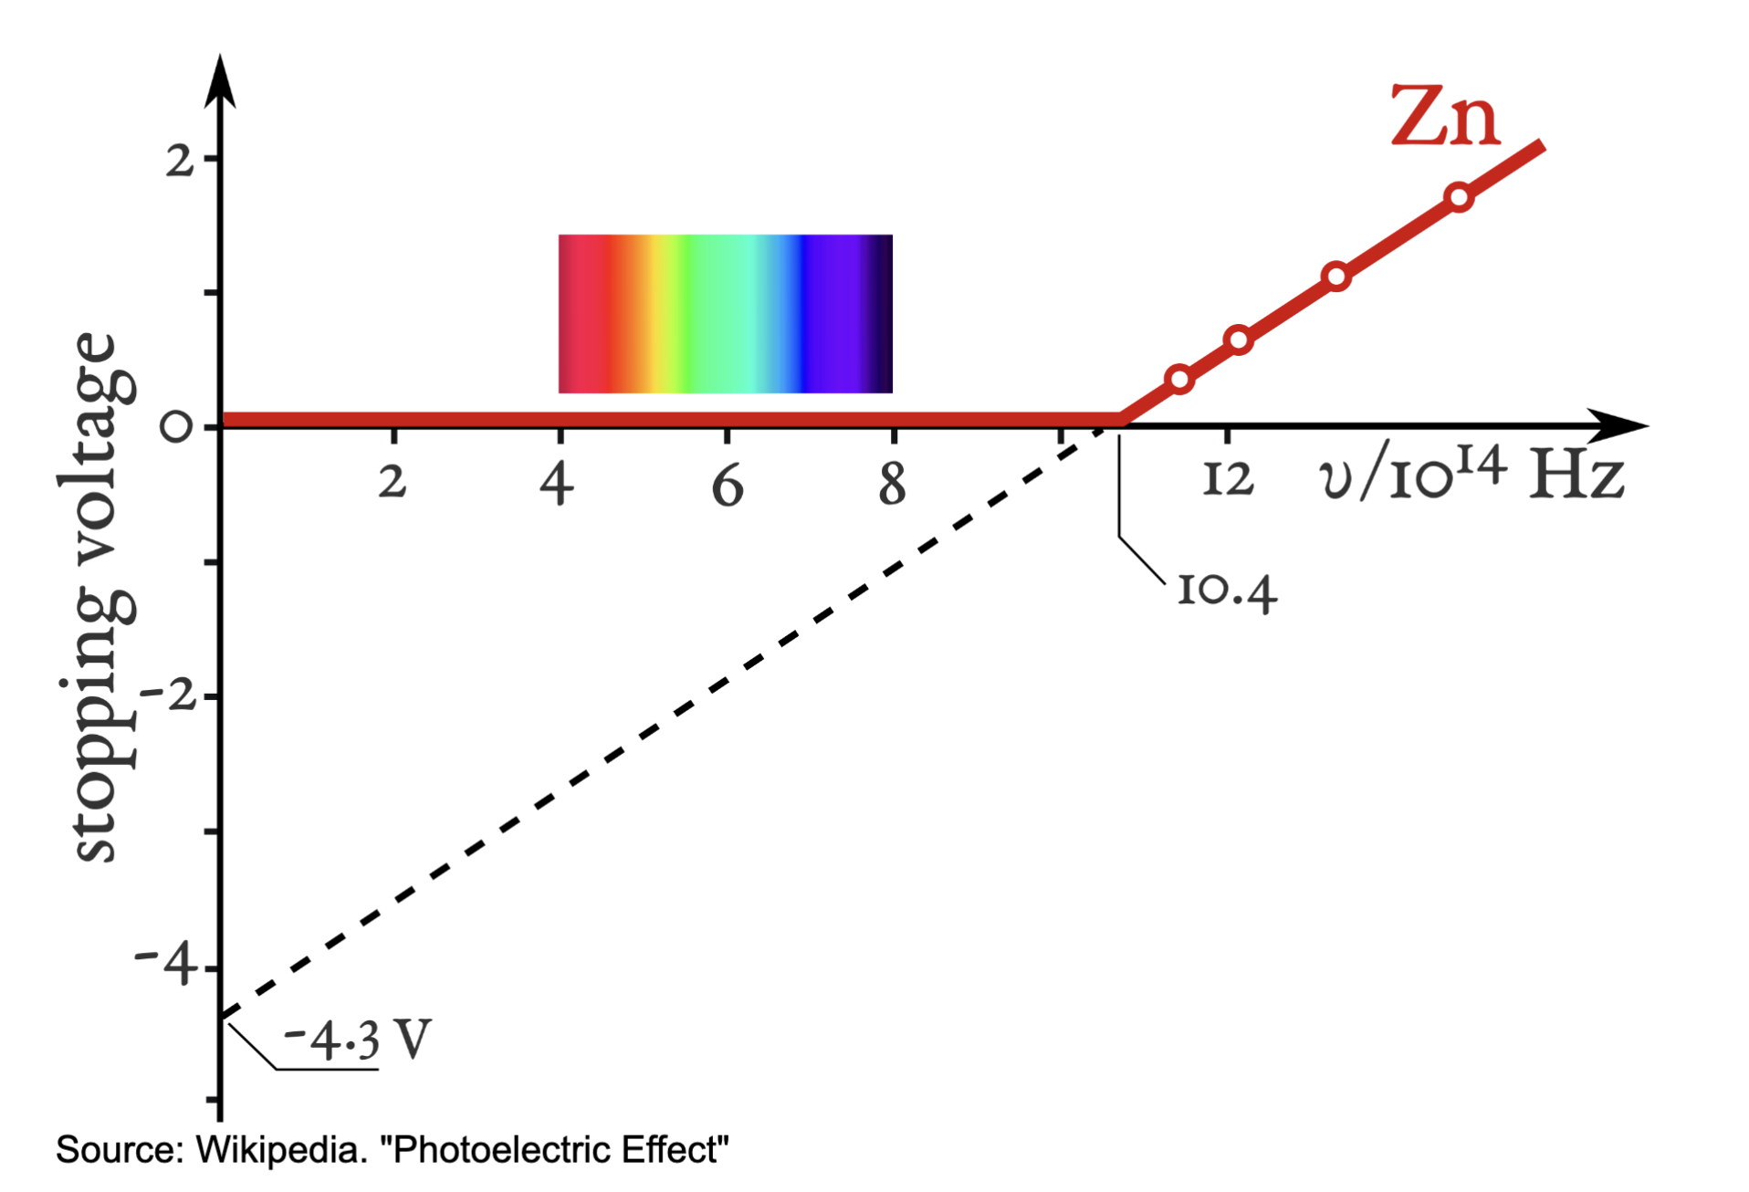
Work Function

Slide 11
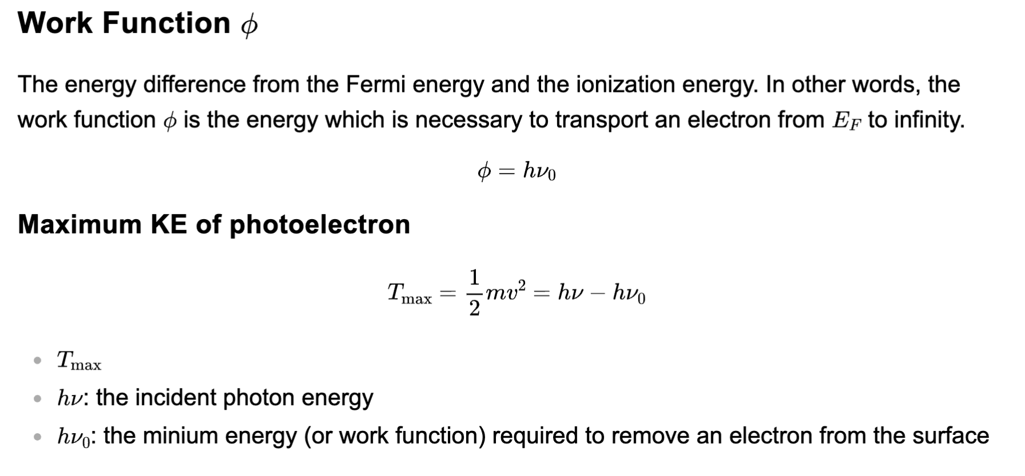
Work Function
Work function is related the fermi energy ($E_{F}).$ The Fermi energy is high occupied ground state.

Slide 12
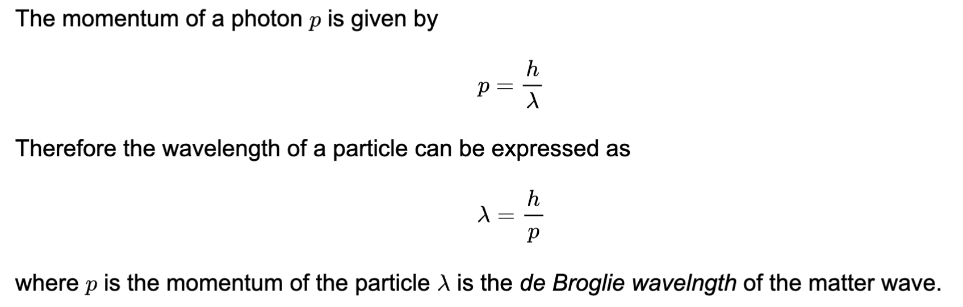
Wave Particle Duality
Wave-Particle Duality Principle (de Broglie 1924)
EM waves have momentum. So it makes sense to talk about them the KE and PE piece.

Slide 13
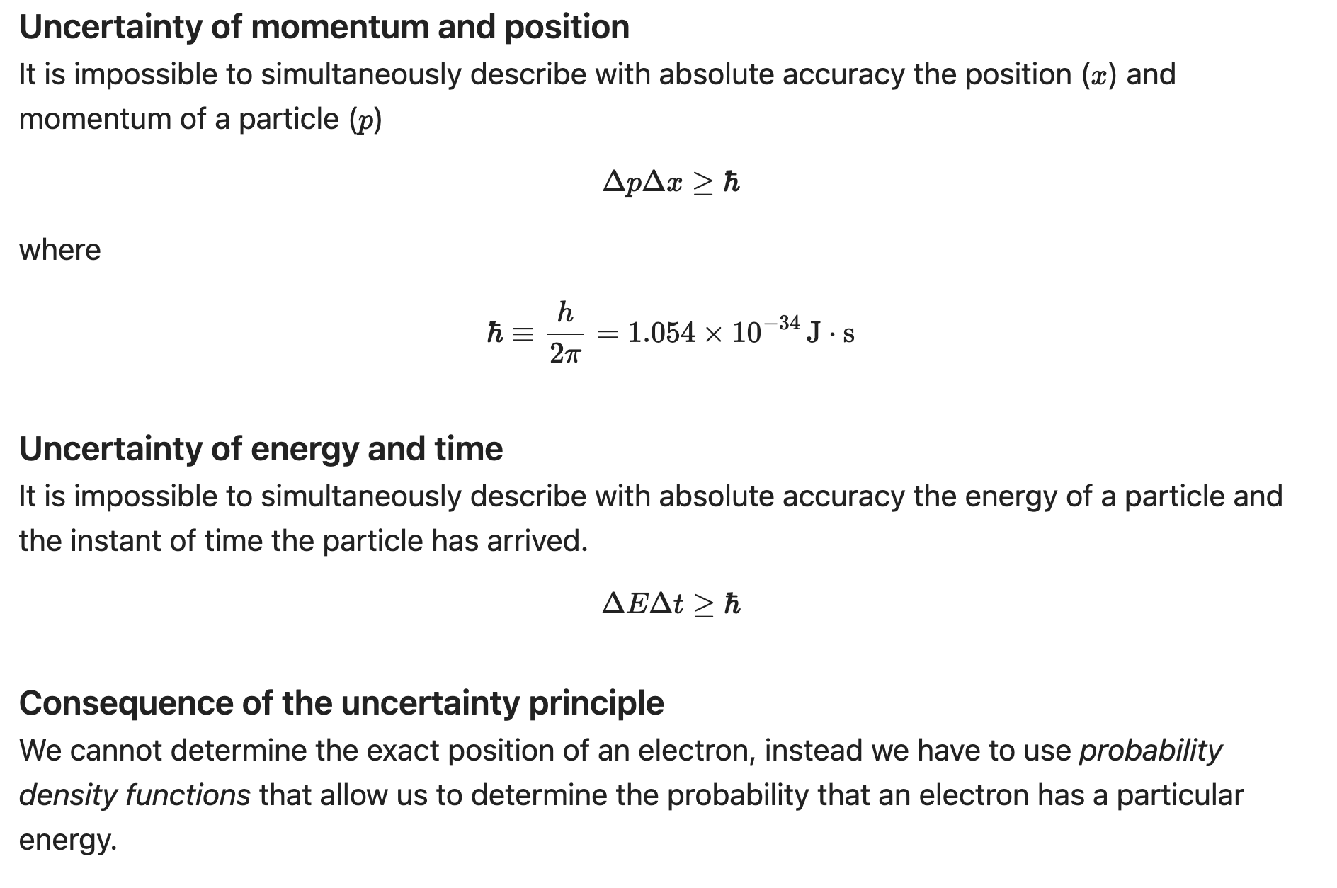
Uncertain Principle

Slide 14








Uncertain Principle in Semiconductors
By adjusting the potentials, we enable ”electron tunneling” through a non-conductive material. “Probabilitistic based conductivity.”
$$BC I$$
$$BC II$$
$$Ψ_{I}(x,t)$$
$$Ψ_{T}(x,t)$$
$$Ψ_{R}(x,t)$$
$$V(x)$$

Slide 15
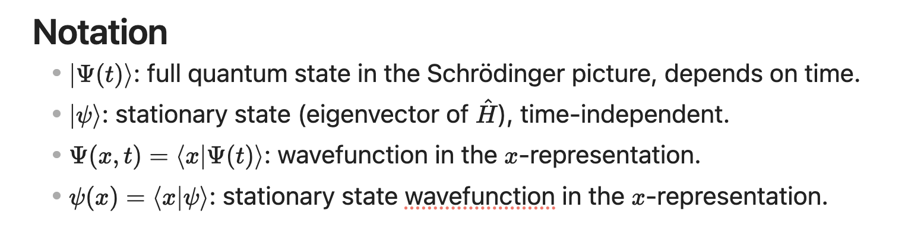
Wave Equation

Slide 16
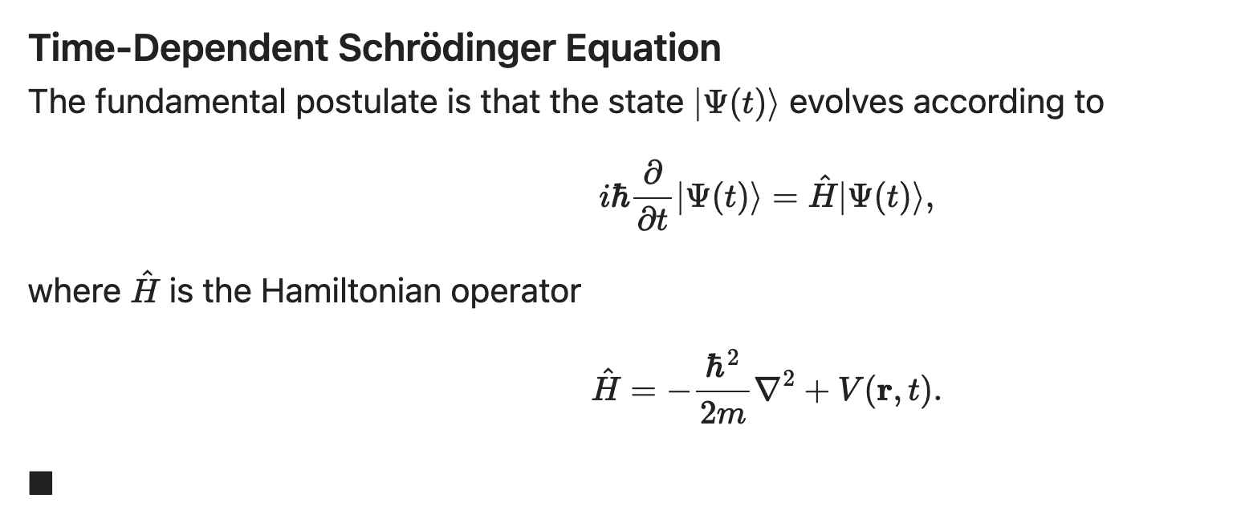
TDSE

Slide 17
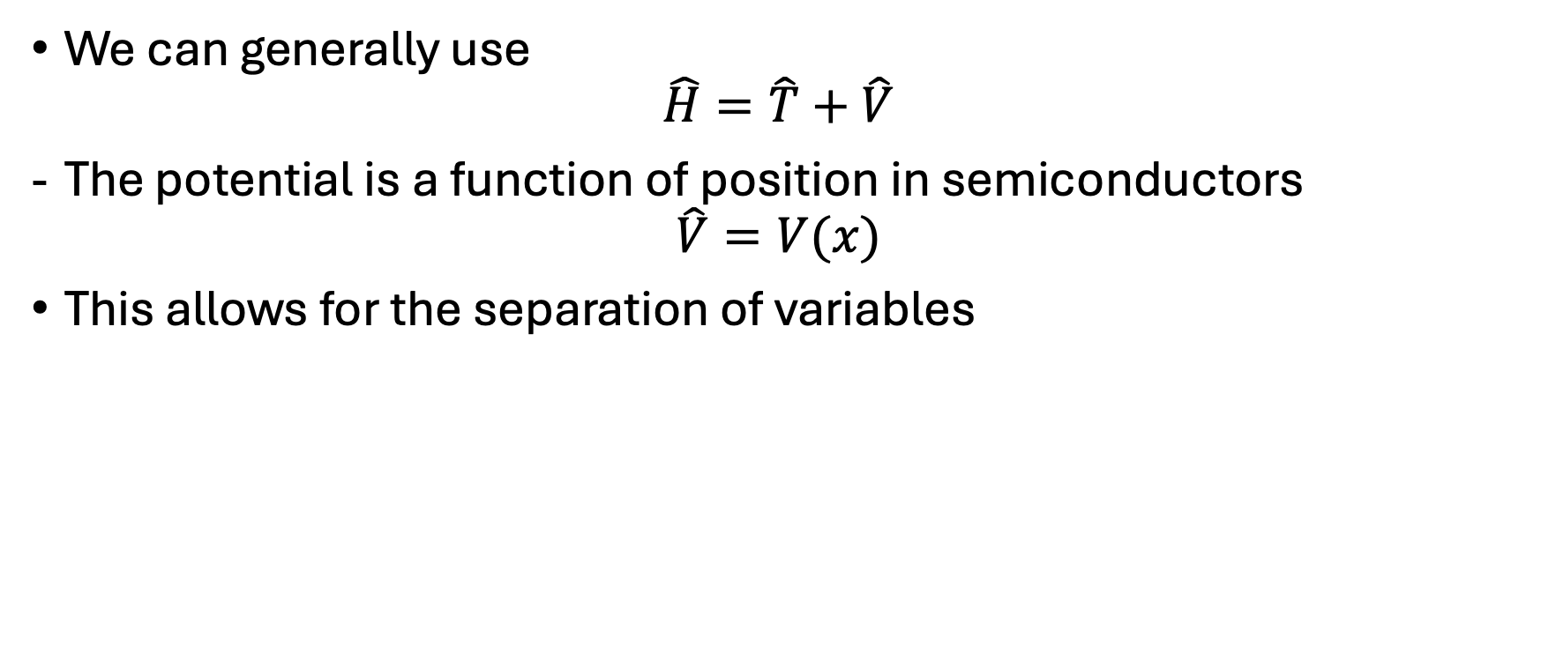
Semicondtors
We can generally use
$$\hat{H}=\hat{T}+\hat{V}$$
The potential is a function of position in semiconductors
$$\hat{V}=V(x)$$
This allows for the separation of variables

Slide 18
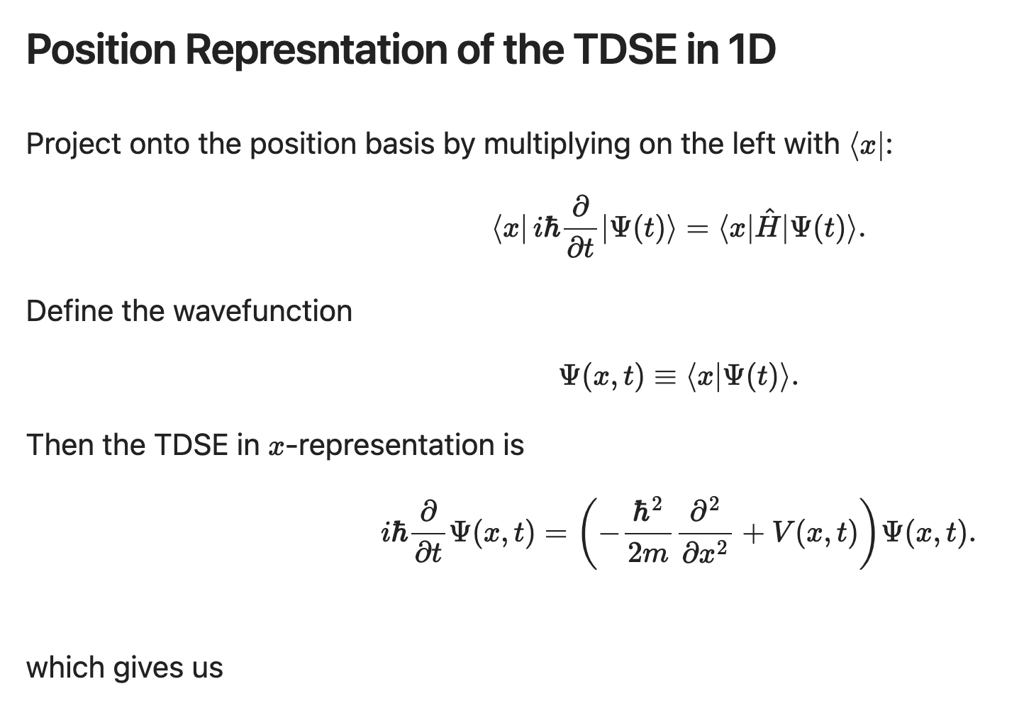

Slide 19
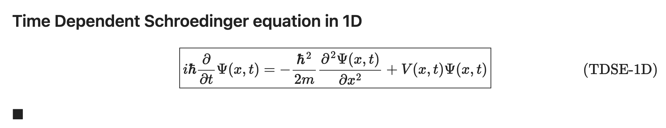

Slide 20
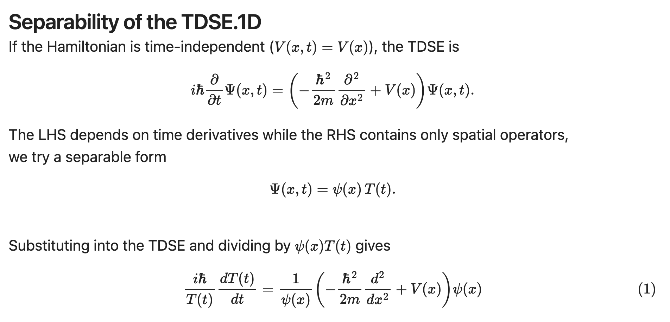

Slide 21
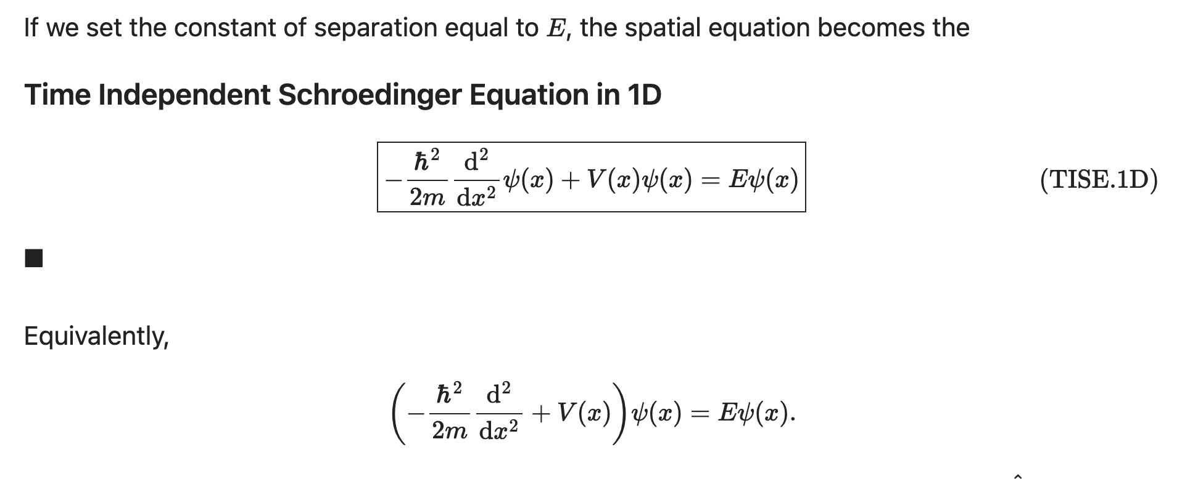

Slide 22
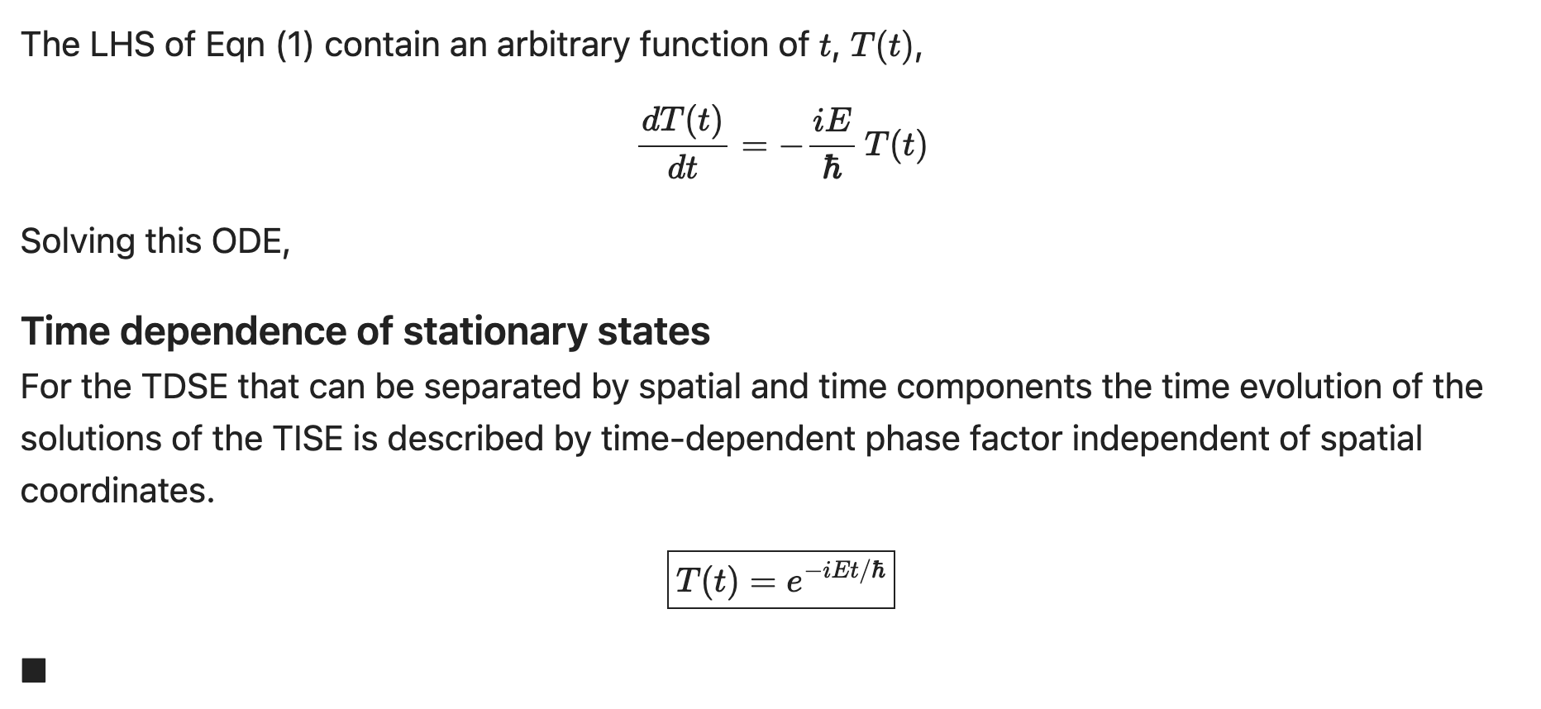
LHS

Slide 23
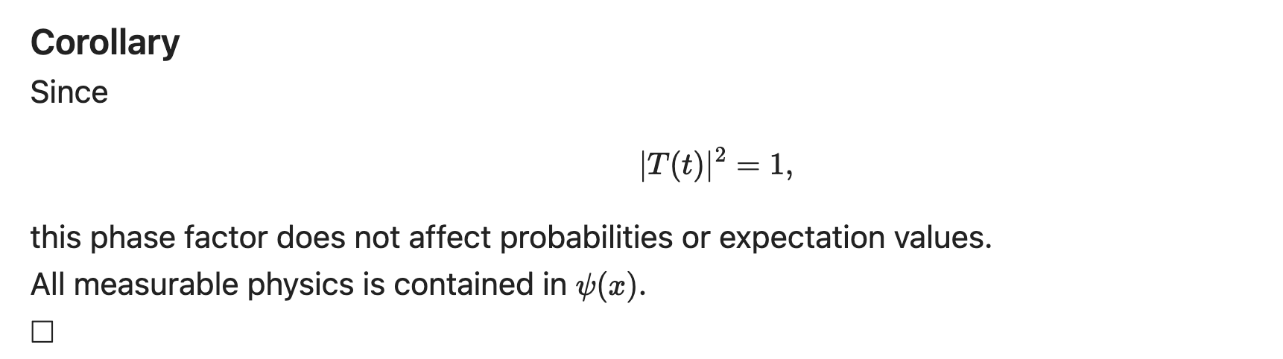

Slide 24
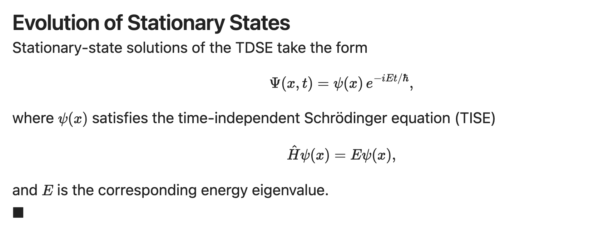
Evolution Stationary States

Slide 25
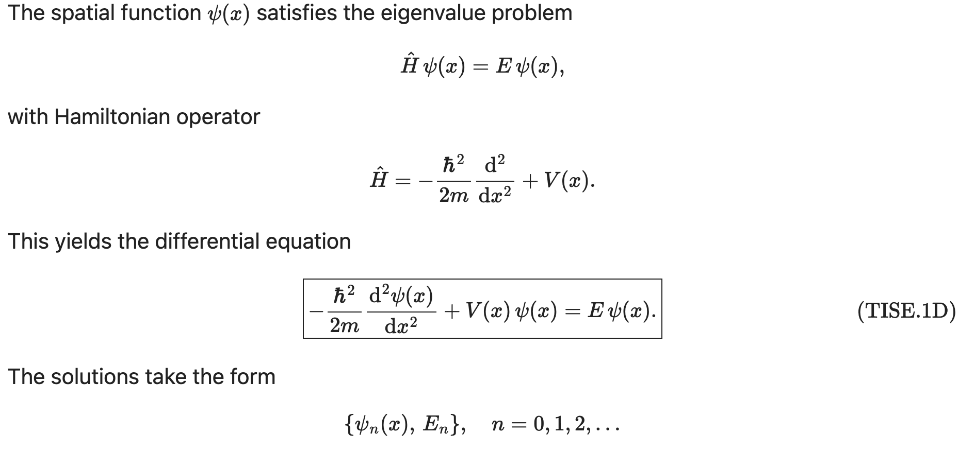
Solutions to the TISE

Slide 26
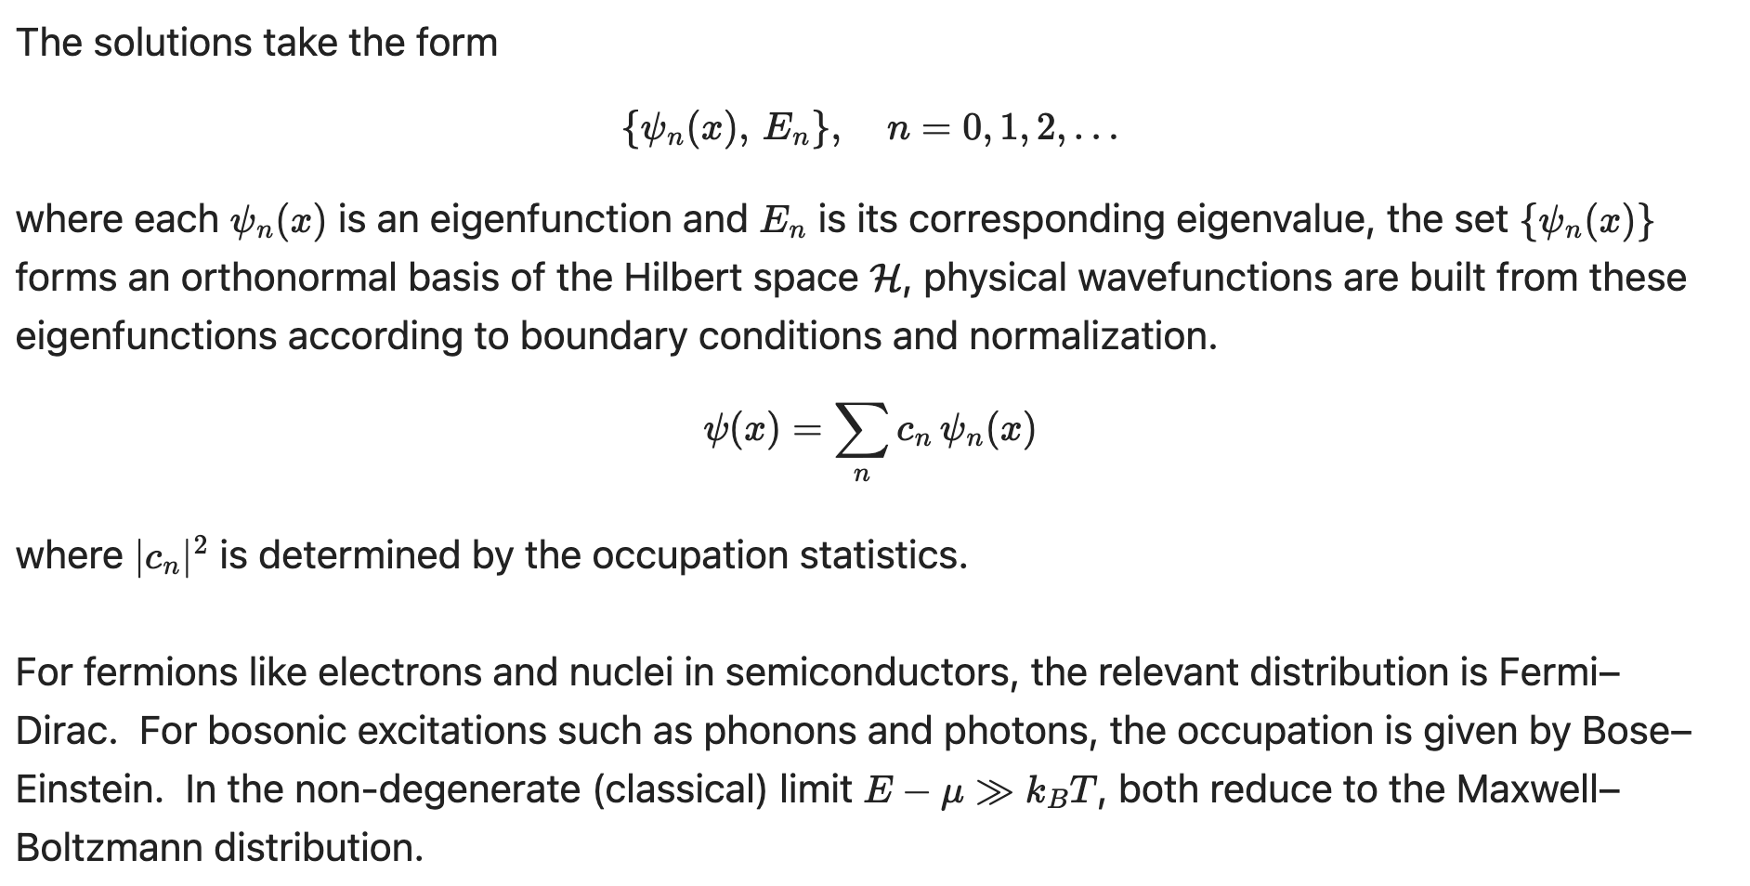


Statistical Mechanics meets Quantum Mechanics
$$DOS:E(k)$$
$$c_{n}:P_{FD}$$

